Slide 1
Photomicrographs of Plant foods
Kiwi
Permission to reproduce original photomicrographs used to make this collection may be obtained from
Dr. David O. Norris at
david.norris@colorado.edu

Slide 2
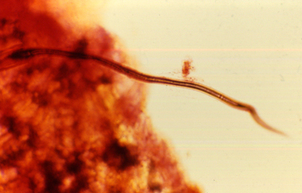
Notes:
259. Actinidia chinensis Planch. Kiwi. Trichome on surface, 25X

Slide 3
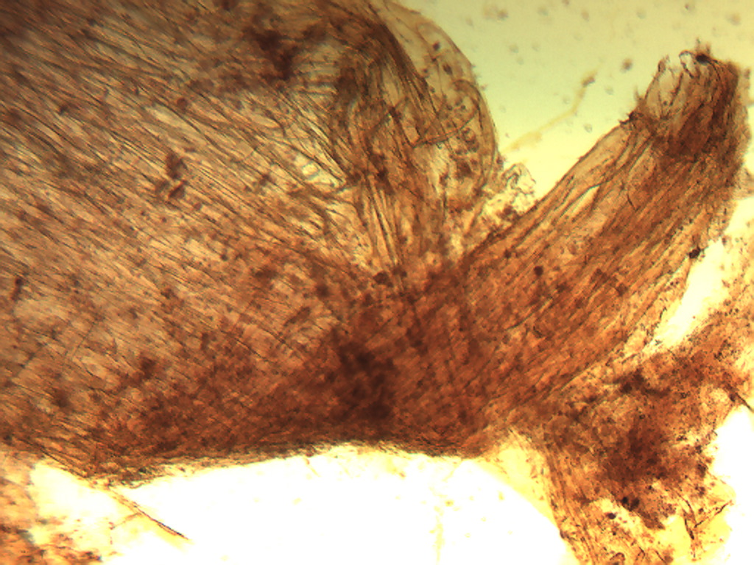
Notes:
260. Kiwi. Elongate cells, 4X

Slide 4
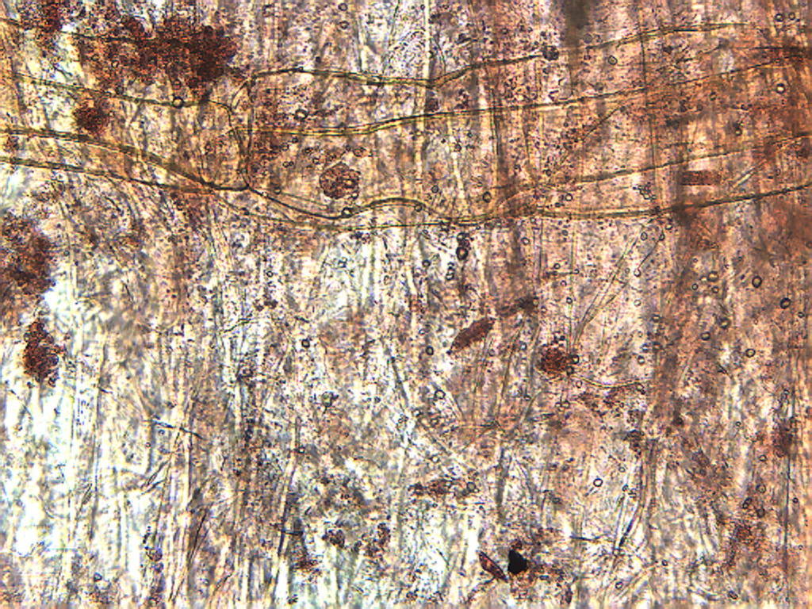
Notes:
261. Kiwi. large elongate cells, 10X

Slide 5
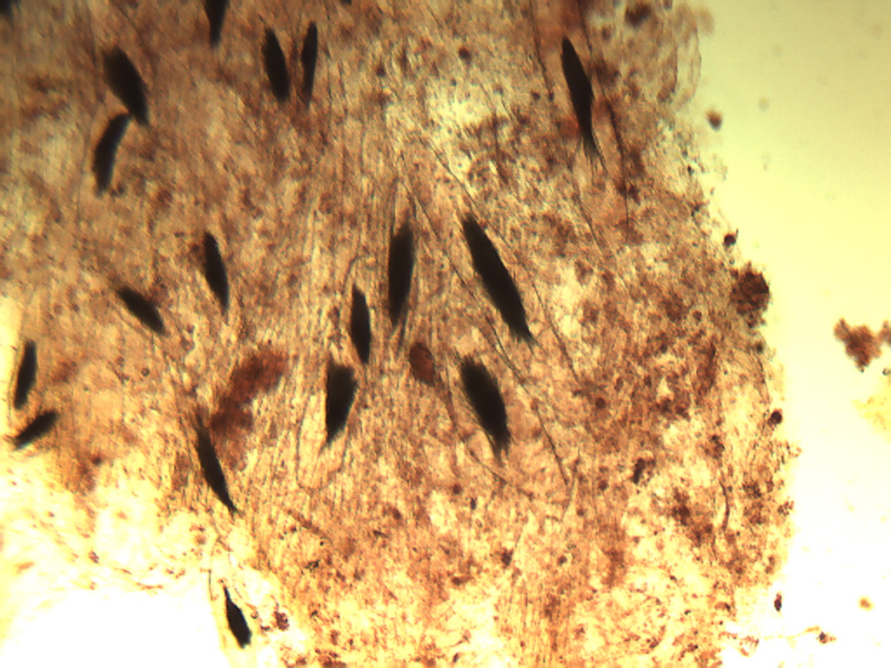
Notes:
262. Kiwi. Large elongate cells containing bundles of raphides (arrows), 4X

Slide 6
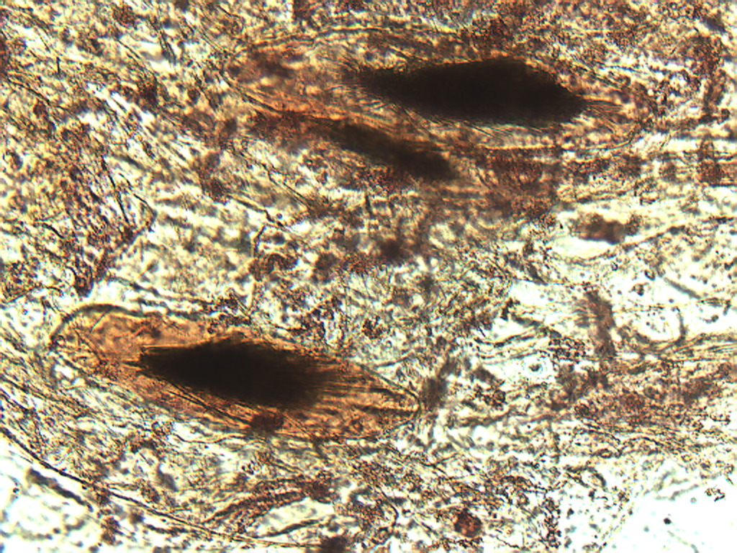
Notes:
263. Kiwi. Large raphide-containing cells stained with safranin, 10X

Slide 7
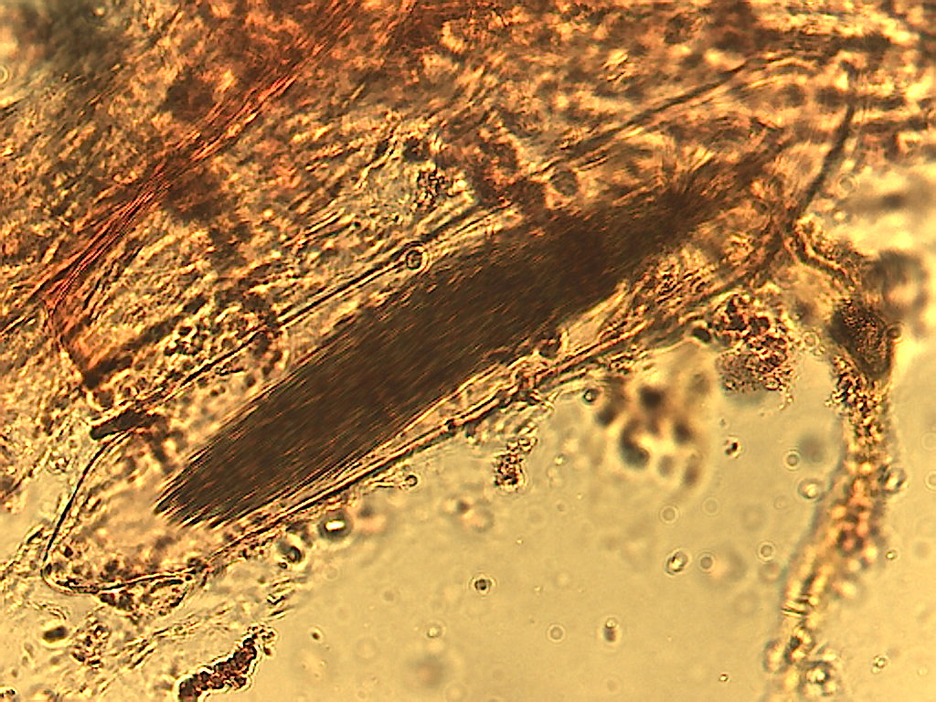
Notes:
264. Kiwi. Cell containing bundle of raphides, 25X.

